Slide 1
Map, from Simon Tatham's Portable Puzzle Collection

Slide 2
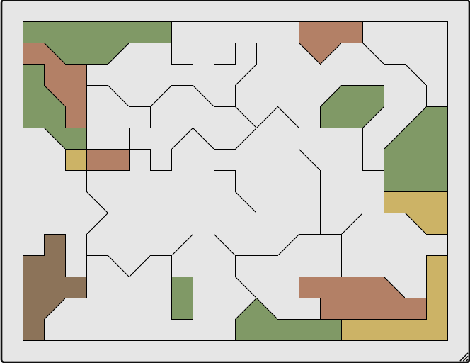
Original Puzzle:
  Regardless of the number of regions, only four colors are used.
Rules:
  Colour the map with four colours, so that no two adjacent regions have the same colour.
  Drag from a coloured region to a blank one to colour the latter the same colour as the former. Drag from outside the grid into a region to erase its colour.

Slide 3
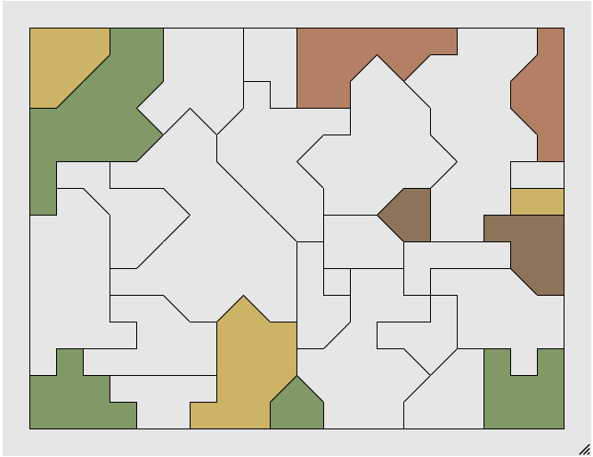
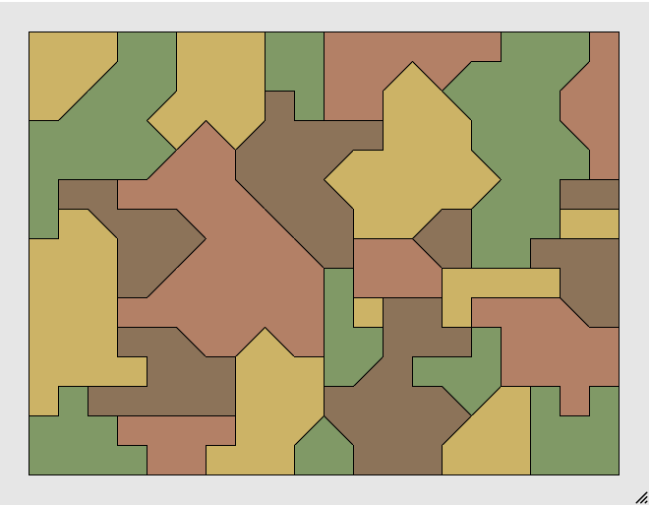
Orginal Puzzle:
Before Solving
After Solving:

Slide 4
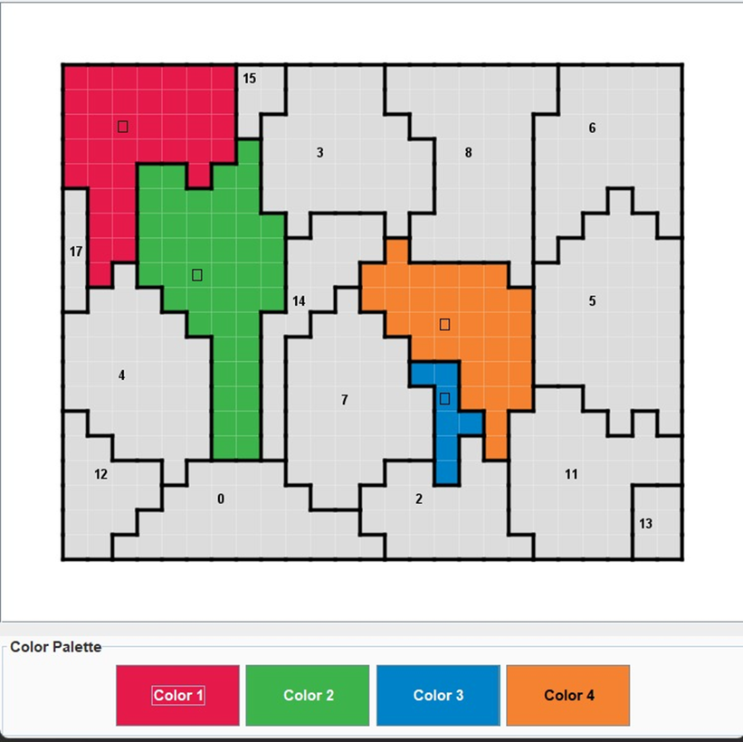
Two Player Map puzzle:
The objective of the game is to cooperatively color all regions of the map such that:
•No two adjacent regions share the same colour.
•Only 4 colours are allowed.
•The puzzle is solved when every region has a valid colour.

Slide 5

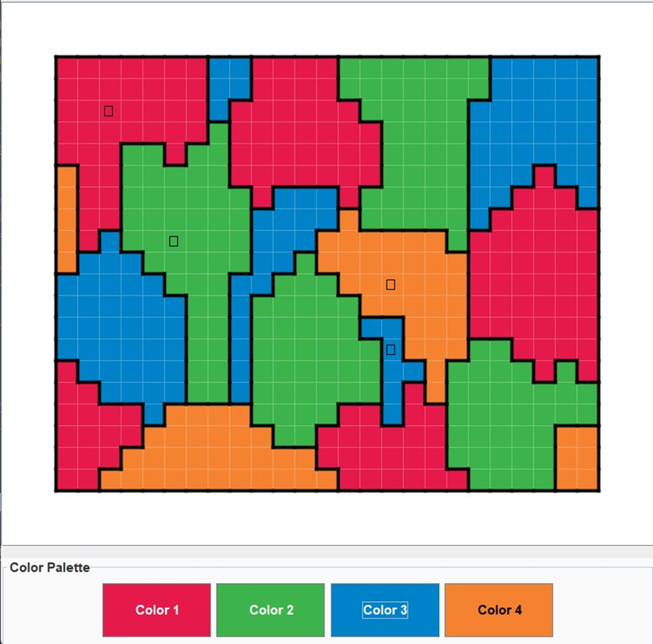
Two Player Map puzzle:
Before Sovling:
After Solving:

Slide 6
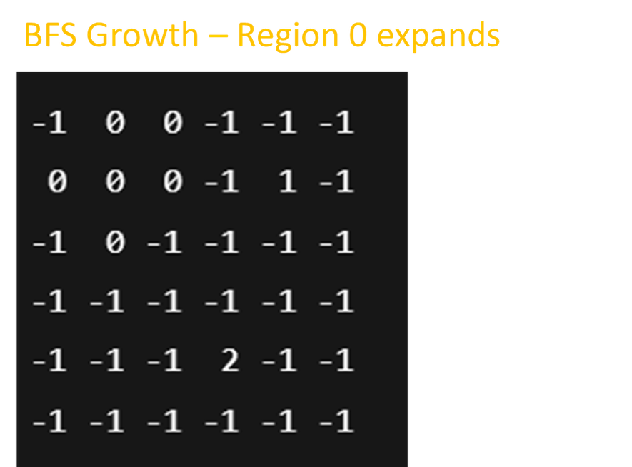
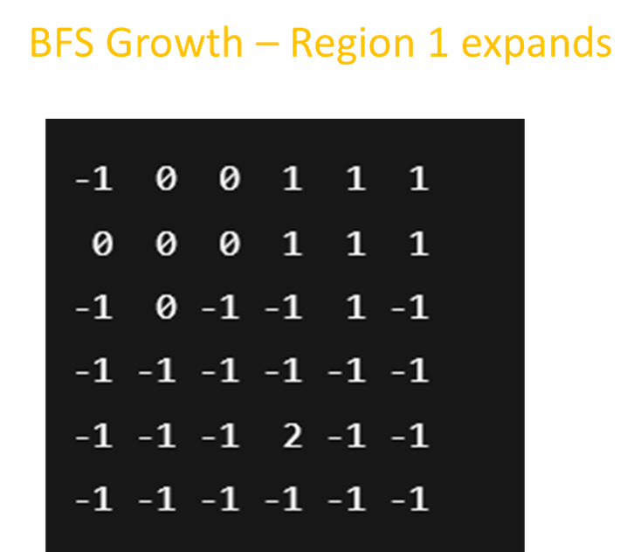
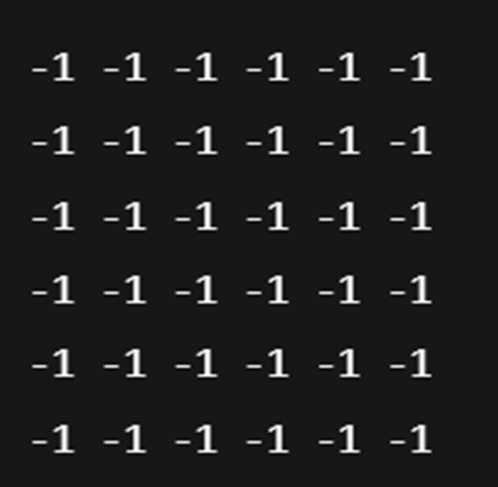
Regions Creation:
Formula for Region size:
int targetAvgSize = totalCells / numRegions;
int targetSize = (int)(targetAvgSize * (0.7 + random.nextDouble() * 0.6));
STEP 1: Grid Initialization
Code:
grid[r][c] = new Cell(r, c);
For Example,
Unassigned=-1
Assume seeds chosen at:
Region 0 → (1,1)
Region 1 → (1,4)
Region 2 → (4,3)
Initially cells:

Slide 7
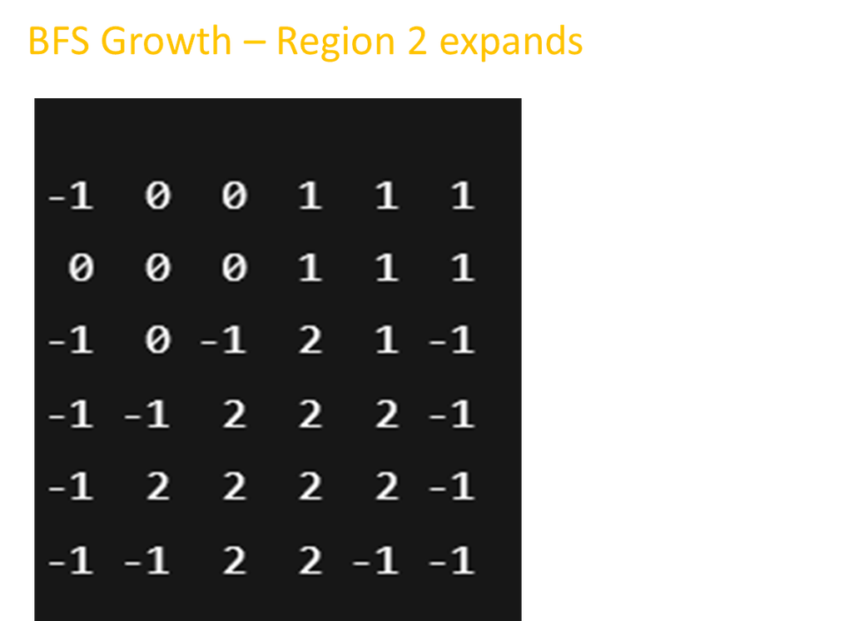
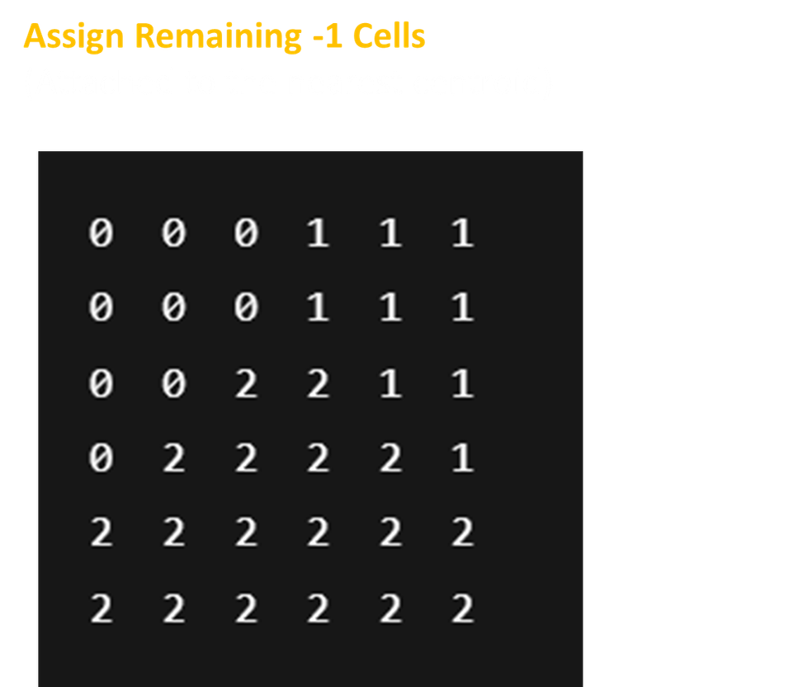
•Now, we have some unassigned cells.

Slide 8
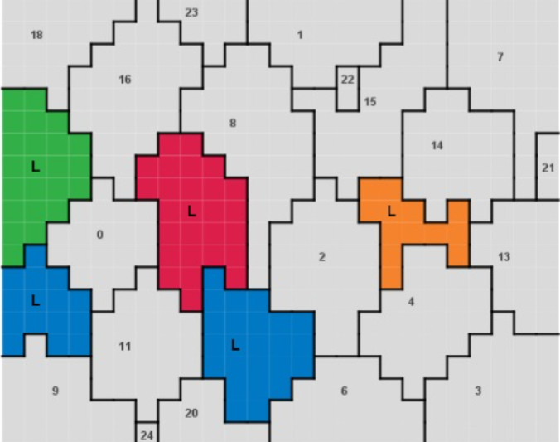
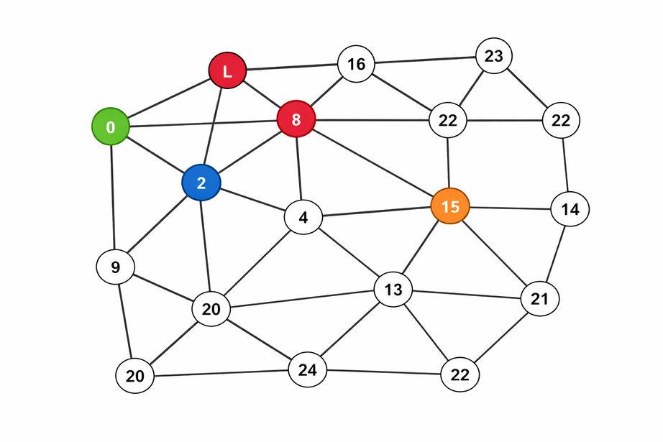
MAP COLORING USING DIVIDE & CONQUER
GameGraph (Core Graph Logic):
This converts regions into a graph.
  Two regions are connected if:
  Their cells touch horizontally or vertically
Adjacency neighbours stored in the form:
Map<Integer, Set<Integer>> adj;

Slide 9
Graph Partitioning Explanation:
Select seed
↓
BFS → find farthest node A
↓
BFS from A → find farthest node B
↓
For each region:
Compare distance to A and B
↓
Assign to Left or Right
Where,
seed=The first region from the list of free (uncolored) regions.

Slide 10
Divide & Conquer Approach:
Merge Flow:
solve( )
↓
Collect free regions
↓
dcSolve(regions)
↓
IF small → Backtracking
ELSE
Divide into Left & Right
↓
Solve Left
↓
Solve Right
↓
Merge (fix seam if needed)
Left solved
Right solved
↓
Check boundary conflicts
↓
If none → SUCCESS
↓
If conflicts:
Collect seam regions
Uncolor seam
Backtrack only seam
↓
If fixed → SUCCESS
Else → FAIL

Slide 11
MRV Selection Flow:(Minimum Remaining value)
Back Tracking Flow:
If all regions colored → return TRUE
Choose region with fewest options (MRV)
For each legal color:
Assign color
Recurse for next region
If success → return TRUE
Undo color (backtrack)
If no color works → return FALSE
For each uncolored region:
Count legal colors
Select region with minimum count

Slide 12
Bot Statergy:
Conflict Check:
Human colors R with C
↓
Check neighbor conflict?
↓
YES
↓
Remove color
↓
Find possible colors
↓
For each color:
Assign temporarily
Run full D&C solver
If solvable → accept
↓
If none solvable:
Try simple local fix
↓
If still none:
Revert
Human Move
↓
Immediate Conflict Check
↓
Run Divide & Conquer
↓
If Solvable:
Accept move
Bot colors most constrained region
Else:
Replace human color with globally safe color

Slide 13
Edge Cases in Our Algorithm:
Edge Case 1:What If Seam Cannot Be Fixed?
Edge Case 2:What If Human Move Makes Puzzle Unsolvable?
Left solved
Right solved
↓
Check seam conflicts
↓
Backtrack seam
↓
If seam cannot be fixed
↓
Return FALSE
Human move
↓
Run D&C solver
↓
If solver returns NULL
↓
Try alternative colors
↓
If none works
↓
Revert move

Slide 14
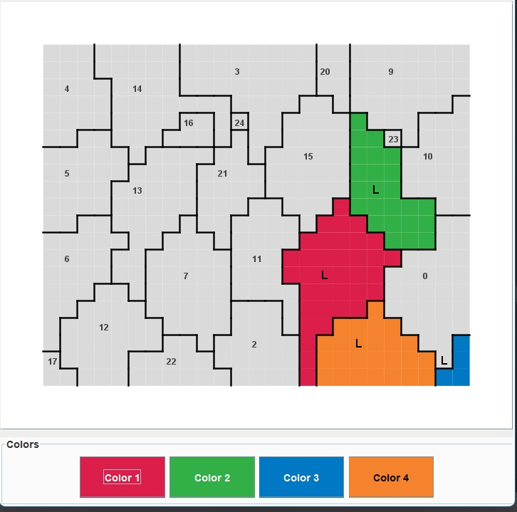
Edge Cases in Our Algorithm:
Edge Case 3:What If No Color Is Available for a Region?
Choose region
↓
Legal colors = empty
↓
Return FALSE
↓
Previous level tries different color

Slide 15
Old Approach vs New Approach:
Start
↓
Collect uncolored regions
↓
If small → Backtracking
Else:
Divide graph into 2 partitions
↓
Recursively solve left
↓
Recursively solve right
↓
Merge and fix seam conflicts
↓
Return globally valid solution
↓
End
Start
↓
Select next region
↓
Pick region with:
• Maximum neighbors
• OR Minimum available colors (MRV)
↓
Assign first legal color
↓
Move to next region
↓
If conflict later → may fail
↓
End

Slide 16
Proof of Correctness:
Base Case (n ≤ BASE_SIZE):
  Uses complete backtracking
  Tries all valid color assignments
  Never assigns conflicting colors
Inductive Hypothesis:
Assume the solver works correctly for ≤ k regions.
Inductive Step (k + 1 regions):
  Divide → Split graph (no constraints removed)
  Conquer → Recursively solve left & right (correct by hypothesis)
  Merge → Detect and repair boundary conflicts using backtracking

